Slide 1

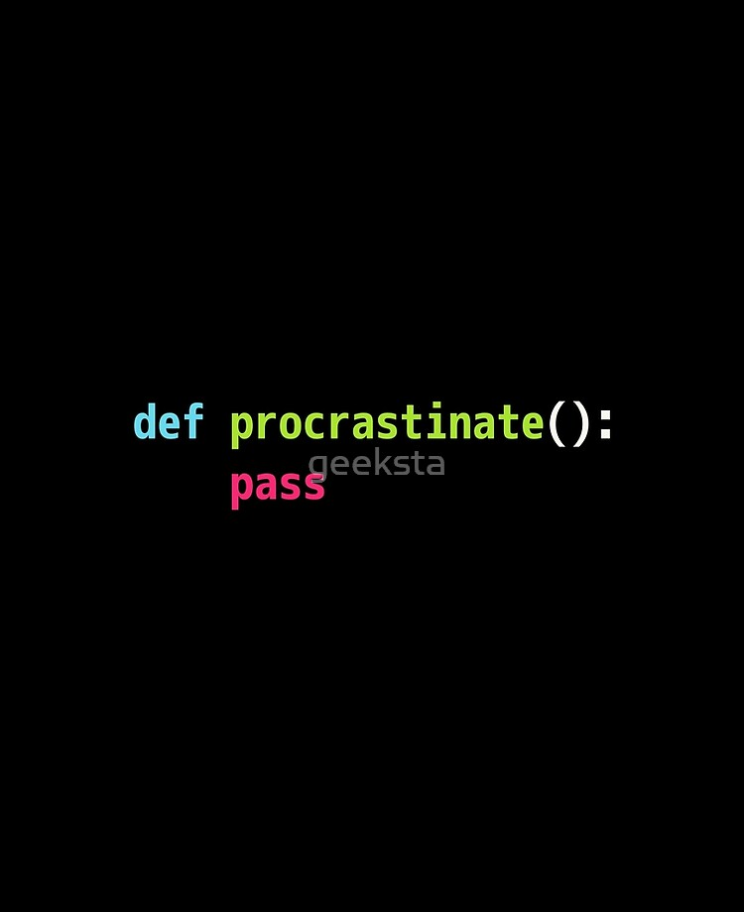
WELCOME TO COFFEE N’ CODE

Slide 2
AGENDA FOR TODAY!
Personal and Group Introduction.
01
Agenda for this entire project.
Brief description about how the project will develop with time and what the final product should look like.
Who I am, Who you guys are, What is this all about? Why Game development and much more.
02
Which Software and Programs are required?
How to install Python and Atom, Which module to use and how to check if Python is really working!
03
Our First Python Program!
Get familiar with Python and Atom, how Atom works and how to have the right mindset while coding games.
04
The Basics of Python.
Demonstrations on how to run a code in Python, basic if-else statements, data types in Python and introduction to
Loops and iterations. Also included will be a coding challenge which will be stressed on the concepts mentioned above.
05
COME BACK NEXT WEEK!
A small talk on how I desperately need you guys to come next week ☺
06

